Slide 1
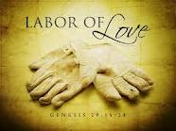
JOURNAL 9/5/12
The IDIOM “labor of love” means work done for one’s own personal satisfaction, rather than money.
Describe a project, activity, or task that you have done recently and really enjoyed doing while working on it.

